Slide 1
Open OnDemand: 1.0, Jupyter, App Development, & Authentication
Basil Mohamed Gohar
Web and Interface Applications Manager
This work is supported by the National Science Foundation of the United States under the award NSF SI2-SSE-1534949.

Slide 2
Open OnDemand Overview
About Open OnDemand
Open OnDemand 1.0 release
Open OnDemand 1.1 features
Integrating Jupyter
Application Development
Keycloak and two-factor authentication
Upcoming and Future

Slide 3
About Open OnDemand
Open source software project
Installable for an HPC cluster (or clusters)
Standalone system, Lab, Department, University or National Resources
More than just an “out of the box” solution
OnDemand is a platform that can be extended through additional and custom apps

Slide 4
Open OnDemand Features
Single point of entry for HPC Center’s services
User needs three things
URL: ood.osc.edu
Username
Password
Zero install (Completely browser based)
Single sign-on
Firewall friendly (Keep traffic on https port)

Slide 5
Open OnDemand Timeline
2016Q4
OSC OnDemand 3.0 released
First usage of Open OnDemand
Beta testing at external sites begins
2017Q1
First public, fully installable release
First webinar
2017Q2
Second webinar
2017Q3
Open OnDemand 1.0 Release
Third webinar

Slide 6
Open OnDemand Overview
About Open OnDemand
Open OnDemand 1.0 release
Open OnDemand 1.1 features
Integrating Jupyter
Application Development
Keycloak and two-factor authentication
Upcoming and Future

Slide 7
Open OnDemand 1.0 – Main Features
Apps
Cluster Access
Gateway
Interactive HPC (iHPC)
Authentication

Slide 8
Open OnDemand – Let’s talk about apps
Open OnDemand functionality is presented through apps
Files browser, My Jobs, Desktop, Jupyter, and others all exist as apps within Open OnDemand
Open OnDemand supports different types of apps
Cluster Access
Gateway
iHPC

Slide 9
Open OnDemand Apps – Cluster Access
They grant access to cluster services as would be available on a login node
e.g., shell, file access, job status
Run on OnDemand server
They do not typically submit jobs

Slide 10
Open OnDemand Apps – Gateway
These are apps that provide some more advanced functionality, typically while also interacting with the batch system
My Jobs
They handle workflows
They submit jobs and provide some basic job management functionality for their own jobs

Slide 11
Open OnDemand Apps – iHPC
iHPC apps are interactive apps that typically execute fully within a job
They allow a client to interact with a running job and perform their work on the compute hardware directly
Examples
Desktop, Jupyter

Slide 12
Open OnDemand 1.0 – Apps
Cluster Access
Dashboard, Files, Editor, Terminal, Active Jobs
Gateway
My Jobs
iHPC
Desktop

Slide 13
Open OnDemand 1.0 – Authentication
HTTP Basic Auth
Community solutions
Shibboleth
Open ID Connect
CILogon
Keycloak

Slide 14
Open OnDemand Overview
About Open OnDemand
Open OnDemand 1.0 release
Open OnDemand 1.1 features
Jupyter Integration
Application Development
Keycloak and two-factor authentication
Upcoming and Future

Slide 15
Open OnDemand 1.1 Features
Next planned release of Open OnDemand
Should be released this month (September 2017)
Features discussed today
Jupyter app example install
Application development
Keycloak & two-factor authentication

Slide 16
Jupyter Integration
Why Jupyter?
A well-known web application frequently used in scientific computing
Allows users to create & share live examples including code, equations, and more
Example of a class of “full web apps” managed by Open OnDemand
Other examples include RStudio, COMSOL Server
Open OnDemand handles authentication and per-user environment and session management
See Dr. David Hudak’s presentation on Open OnDemand for more Jupyter examples
https://youtu.be/UCmzwV37Ta4?t=2521

Slide 17
Jupyter Example (Integration Plotting)
Goals:
Launching and connecting to Jupyter Notebook Server on a compute node
Uploading an iPython notebook file (example-integrate.ipynb) to your home directory
Opening and running the notebook file

Slide 18
Open OnDemand Overview
About Open OnDemand
Open OnDemand 1.0 release
Open OnDemand 1.1 features
Integrating Jupyter
Application Development
Keycloak and two-factor authentication
Upcoming and Future

Slide 19
Why care about apps?
We would never be able to write all the apps everyone will ever need.
The vision of Open OnDemand is to provide a platform on which further apps can be developed beyond what we ourselves can do
Each center knows best what their clients needs, we can only anticipate in the most general terms
Custom apps can greatly extend the utility and usefulness of Open OnDemand

Slide 20
Application Development
Extend Open OnDemand with your own custom applications
New toggleable development menu
Restart apps
Access documentation (configurable)
Clone, edit, & test your own apps in the new sandbox development environment

Slide 21
Application Development
Interactive demo
ps example app converted to quota app

Slide 22
Open OnDemand Overview
About Open OnDemand
Open OnDemand 1.0 release
Open OnDemand 1.1 features
Integrating Jupyter
Application Development
Keycloak and two-factor authentication
Upcoming and Future

Slide 23
Authentication in OnDemand
Apache is the entry point
For each authentication mechanism you must:
configure apache to protect resources via authentication
configure apache to map authenticated user to system user
Any method of configuring Apache for authentication can potentially be used for Open OnDemand

Slide 24
Authentication: 2 currently supported options
Basic auth via mod_authnz_ldap
Federated authentication
Two popular kinds
Shibboleth via mod_shib
OpenID Connect via mod_auth_oidc
Available via
Campus wide authentication (Shibboleth or OpenID Connect or CILogon)
Local identity provider (run your own IDP server configured against LDAP)

Slide 25
Federated Authentication: example deployments
Two outside institutions are working with Open OnDemand and have configured it with pre-existing federated authentication systems
OSC previously used a local Shibboleth IDP for our AweSim Open OnDemand portal
OSC also uses CILogon to make use of OSU’s Campus wide authentication
OSC now uses OpenID Connect for both AweSim and OSC OnDemand via a locally installed KeyCloak server
We plan to provide basic documentation on these options in the future
We will provide detailed documentation on setting up a KeyCloak server as a local IDP in Open OnDemand 1.1

Slide 26
Federated Authentication via KeyCloak vs Basic Auth
Basic Auth drawbacks
Each request includes username and password
Slow: each request makes request to LDAP server
Logout only possible client side by closing browser
Safari bug preventing web socket connections (breaks OOD Terminal app)
Keycloak benefits
Session based authentication (via OpenID connect)
Branded login
2 Factor Authentication support out of the box with Google Authenticator and Redhat’s FreeOTP
2FA can be per user or enforced for every user

Slide 27
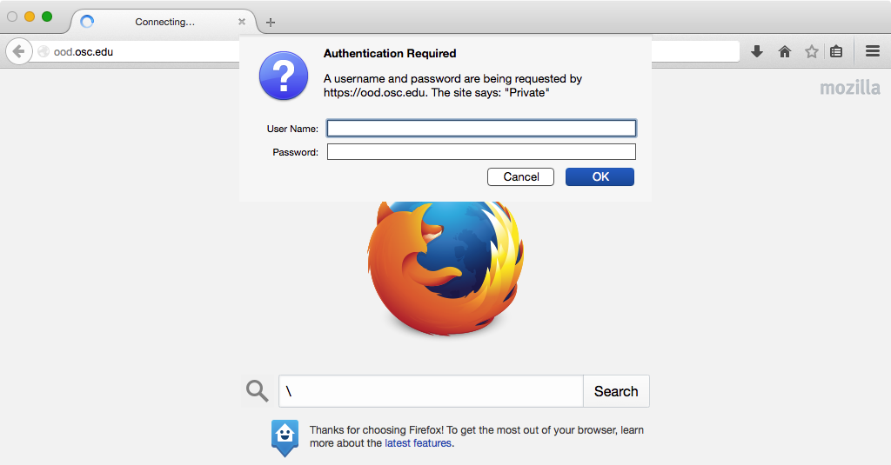
Basic Auth Screenshot

Slide 28
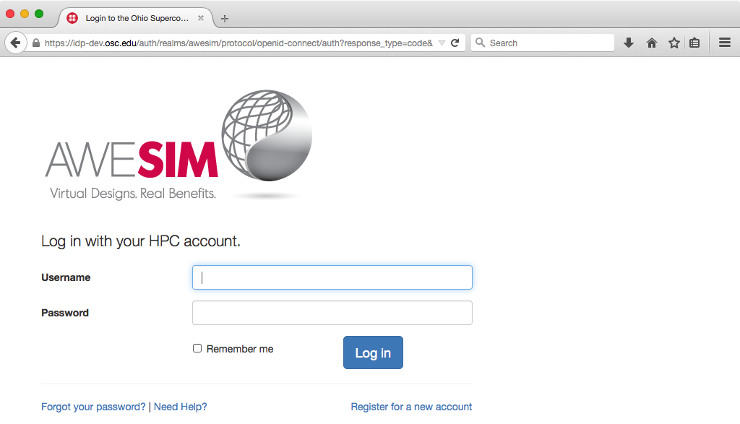
KeyCloak Screenshot 1: branded login

Slide 29
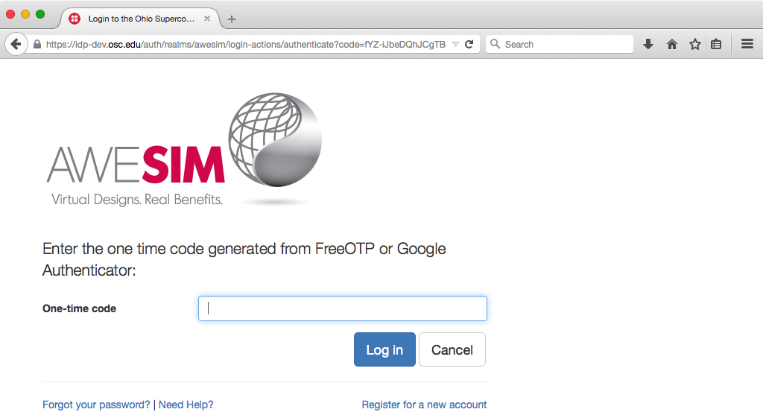
KeyCloak Screenshot 2: 2FA/OTP

Slide 30


KeyCloak Screenshot 3: 2FA/OTP iOS apps

Slide 31
KeyCloak considerations
Drawbacks with the complexity of installation and branding
Requires separate host, Apache reverse-proxy configuration, SSL certificate
May require a separate database and system user/group
mod_auth_openidc needs to be compiled against httpd24
Keycloak theme added and modified
No duo support for 2FA built in
Are these actually drawbacks? Feedback would be helpful.
Solutions we are investigating include
Simplifying KeyCloak installation by automating or workaround some of these steps
Build a custom duo plugin to KeyCloak
Build a custom Apache authentication module for a simpler non-federated option

Slide 32
Open OnDemand Overview
About Open OnDemand
Open OnDemand 1.0 release
Open OnDemand 1.1 features
Integrating Jupyter
Application Development
Keycloak and two-factor authentication
Upcoming and Future

Slide 33
Upcoming and Future
Gateways 2017 Demo – Come meet us!
Demo: Developing Apps to Extend Open OnDemand
Tuesday, October 24 • 12:55pm - 2:20pm
http://sched.co/Bl3h
Upcoming & planned features
Globus Online integration
Open XDMoD integration
Packaging and simpler installation
Suggestions?

Slide 34
Get Engaged and get Open OnDemand!
Open OnDemand is installed or being explored at more than half a dozen external sites
We are happy to work with you getting Open OnDemand installed at your site too

Slide 35
Next Webinar/Staying in Touch
Our webinars are planned roughly quarterly
Let us know what you’d like to learn about next
Visit our website
https://osc.github.io/Open-OnDemand/
Join our mailing list
https://lists.osu.edu/mailman/listinfo/ood-users
Get Open OnDemand!
https://github.com/OSC/Open-OnDemand

Slide 36
Thank you! Any questions?
Basil Mohamed Gohar
Web and Interface Applications Manager
Ohio Supercomputer Center
bgohar@osc.edu
https://osc.github.io/Open-OnDemand/
go.osu.edu/ood

